Slide 1

Department of
Artificial Intelligence and Machine Learning
B.Tech III Semester Academic Year 2026-2027
Data Base Management Systems (2501IT05)
Capstone Stone Project Documentation
ADITYA UNIVERSITY
Surampalem, Kakinada District Andhra Pradesh-533437

Slide 2

LIBRARY MANAGEMENT SYSTEM
A DBMS Cornerstone Project Report submitted in partial fulfillment of the requirements for the award of the degree of
BACHELOR OF TECHNOLOGY
in
ARTIFICIAL INTELLIGENCE AND MACHINE LEARNING
Submitted By
A. AJAY – 25B11AIB78
T. SAI MANISH – 25B11AIB78
T. JASWANTH – 25B11AIB83
Y. HEMANTH – 25B11AIC91
Under the esteemed guidance of
Ms. G. Sravani
Assistant Professor
DEPARTMENT OF ARTIFICIAL INTELLIGENCE AND MACHINE LEARNING
ADITYA UNIVERSITY
Aditya Nagar, ADB Road, Surampalem, Andhra Pradesh, India
2026 – 2027

Slide 3

Aditya Nagar, ADB Road, Surampalem, Andhra Pradesh, India
DEPARTMENT OF ARTIFICIAL INTELLIGENCE AND MACHINE LEARNING
CERTIFICATE
This is to certify that the DBMS Cornerstone Project report entitled “Library Management System” is being submitted by A. AJAY (Roll No. 25B11AIB78), T. SAI MANISH (Roll No. 25B11AIB78), T. JASWANTH (Roll No. 25B11AIB83) and Y. HEMANTH (Roll No.
25B11AIC91) in partial fulfillment of the requirements for the award of the B.Tech. degree in Artificial Intelligence and Machine Learning. The work documented in this report was carried out as part of the Cornerstone Project for the course Database Management Systems
(2501IT05) during the academic year 2026–2027, and records the database design, implementation, and documentation undertaken by the team.
Project Guide Ms. G. Sravani Assistant Professor | Head of the Department Dr. K. Naga Bhargavi, M.Tech, Ph.D. Associate Professor & HOD
External Examiner

Slide 4
DECLARATION
We hereby declare that the DBMS Cornerstone Project entitled “Library Management System” is a genuine work carried out by us. The database design, SQL implementation, queries and documentation presented in this report are our own work, completed under the guidance of Ms.
G. Sravani, Department of Artificial Intelligence and Machine Learning, Aditya University, Surampalem. We further declare that this work has not been submitted, in full or in part, for the award of any degree of this or any other educational institution.
Project Associates
A. AJAY (25B11AIB78)
T. SAI MANISH (25B11AIB78)
T. JASWANTH (25B11AIB83)
Y. HEMANTH (25B11AIC91)
Date: Place: Surampalem

Slide 5
ACKNOWLEDGEMENT
It is with immense pleasure that we express our indebted gratitude to our project guide Ms. G. Sravani, Department of Artificial Intelligence and Machine Learning, who guided us throughout the cornerstone project. We are thankful for the constant encouragement and valuable suggestions received at every review stage.
We are grateful to Dr. K. Naga Bhargavi, Head of the Department, for inspiring us and for arranging the facilities and resources needed for this project.
We extend our sincere thanks to the Management, Dr. M. Sreenivasa Reddy, Deputy Pro-Chancellor, Dr. M. B. Srinivas, Vice-Chancellor, and Dr. A. Ramesh, Pro Vice-Chancellor (Engineering & Sciences), for providing an excellent academic environment.
Not to forget, we thank the Teaching and Non-Teaching Staff, our parents and our friends, who have directly or indirectly supported us in completing this project on time.
Project Associates
A. AJAY (25B11AIB78)
T. SAI MANISH (25B11AIB78)
T. JASWANTH (25B11AIB83)
Y. HEMANTH (25B11AIC91)

Slide 6
ADITYA UNIVERSITY
Surampalem
Department of Artificial Intelligence and Machine Learning
DBMS CORNERSTONE PROJECT
Project Documentation Report
Project Title: Library Management System
Submitted by:
S.No | Student Name | Roll Number
1 | A. AJAY | 25B11AIB78
2 | T. SAI MANISH | 25B11AIB78
3 | T. JASWANTH | 25B11AIB83
4 | Y. HEMANTH | 25B11AIC91
Course: Database Management Systems (DBMS) Project Guide: Ms. G. Sravani
Academic Year: 2026–27
Date of Submission:
Course Code: 2501IT05
GitHub Repository Link: https://github.com/saimanish11887/Library-_management_-system.git

Slide 7
TABLE OF CONTENTS
Chapter | Title | Page No.
 | Certificate | 3
 | Declaration | 4
 | Acknowledgement | 5
 | Project Documentation Report | 6
1 | ABSTRACT | 8
 | List of Figures | 9
 | List of Tables | 9
2 | INTRODUCTION | 10
 | 2.1 Background | 10
 | 2.2 Purpose of the Database | 10
3 | PROBLEM STATEMENT | 11
4 | OBJECTIVES | 12
5 | TOOLS & TECHNOLOGIES USED | 13
6 | DATABASE DESIGN | 14
 | 6.1 Identified Entities | 14
 | 6.2 Entity Attributes | 14
 | 6.3 ER Diagram | 15
 | 6.4 Relationships & Cardinality | 16
 | 6.5 Relational Database Schema | 17
 | 6.6 Primary & Foreign Keys | 18
7 | DATABASE IMPLEMENTATION | 19
 | 7.1 DDL – Database and Table Creation | 19
 | 7.2 Sample Data – DML | 20
 | 7.3 Constraints & Data Integrity | 21
 | 7.4 SQL Operations & Queries | 22
 | 7.5 Sample Outputs | 24
8 | MODULES & FUNCTIONALITIES | 25
9 | GITHUB REPOSITORY & TEAM RESPONSIBILITIES | 26
10 | ENHANCEMENTS & FUTURE IMPROVEMENTS | 26
11 | CONCLUSION | 27
12 | REFERENCES | 27

Slide 8
1. ABSTRACT
The Library Management System is a relational database application designed to help a library manage its books, members and borrowing and returning activities efficiently. It stores and links the details of books, publishers, members, librarians and loan transactions, which are otherwise kept in manual registers and separate records.
The system consists of five main entities: Book, Member, Librarian, Loan and Publisher, connected through one-to-many relationships that are implemented with primary and foreign keys. Data integrity is protected using PRIMARY KEY, FOREIGN KEY, NOT NULL, UNIQUE, DEFAULT and CHECK constraints, so that duplicate, missing, invalid or orphaned records are controlled by the database itself.
The database supports book inventory management, member registration, issue and return of books, and tracking of due dates and availability. It was implemented in SQL and exercised with DDL, DML and DQL operations, CRUD operations and join queries that list the books currently issued and the books that are overdue. Sample records were inserted into all five tables.
Keywords: Relational Database, Library Management, ER Diagram, Primary Key, Foreign Key, Constraints, SQL, CRUD Operations.

Slide 9
LIST OF FIGURES
Figure No. | Title of the Figure | Page No.
6.3 | ER Diagram of the Library Management System | 16
6.5 | Relational Schema of the Library Management System | 17
Output 1 | Structure of the Book table | 24
Output 2 | Structure of the Publisher table | 24
Output 3 | Structure of the Member table | 24
Output 4 | Structure of the Librarian table | 2
LIST OF TABLES
Table No. | Title of the Table | Page No.
5 | TOOLS & TECHNOLOGIES USED | 13
6.1 | Identified Entities | 14
6.2 | Entity Attributes | 14
6.4 | Relationships & Cardinality | 16
6.5 | Relational Database Schema | 17
6.6 | Primary & Foreign Keys | 18
7.2 | Sample Data – DML | 20
7.3 | Constraints & Data Integrity | 21
7.4 | SQL Operations & Queries | 22
8 | MODULES & FUNCTIONALITIES | 26
9 | GITHUB REPOSITORY & TEAM RESPONSIBILITIES | 27

Slide 10
2. INTRODUCTION
  Background
A library handles a large number of books, members and borrowing transactions every day. Traditional library systems rely on manual record-keeping, which is time-consuming, error-
prone and difficult to scale as the collection and the number of members grow. A relational database is required to store this information in a structured way and to maintain the relationships between the different records. In this project, the library domain is represented using five related tables: Book, Member, Librarian, Loan and Publisher. The schema separates data into appropriate entities and uses keys and constraints to reduce duplication and protect data integrity. SQL queries are then used to insert, retrieve, update and delete the stored information.
  Purpose of the Database
The database provides a centralized structure for managing book inventory, publisher details, member registration, librarian details and the issue and return of books. It supports library staff who need to see which books are currently issued, who has borrowed them, when they are due
and which books are overdue. The relationships between the tables allow related information to be accessed through SQL joins instead of maintaining disconnected records.
3. PROBLEM STATEMENT
Traditional library systems rely on manual record-keeping, which is time-consuming, error-prone and difficult to scale. There is a need for a computerized system that can efficiently manage books, members and transactions while maintaining data accuracy and integrity.
The proposed system centralizes book, publisher, member, librarian and loan information into a single relational database. It provides structured data management, referential integrity, validation and SQL-based querying so that library information can be stored, accessed, updated and managed easily and efficiently.

Slide 11
4. OBJECTIVES
Identify Entities and Attributes: Identify the entities and attributes required for a library system.
Design the ER Diagram: Design an Entity-Relationship (ER) diagram that maps the entities and their relationships clearly.
Create the Relational Schema: Convert the ER diagram into a relational schema.
Implement with Constraints: Implement the database with proper constraints such as primary keys, foreign keys, NOT NULL, UNIQUE and DEFAULT.
Perform CRUD Operations and Queries: Perform CRUD operations and complex queries on the stored data.
Ensure Data Integrity and Validation: Ensure that the stored data stays accurate, consistent and valid.

Slide 12
5. TOOLS & TECHNOLOGIES USED
Category | Tool / Technology Used
Database Server | MySQL-compatible relational database
Query / Admin Tool | SQL client / SQL environment
Language | SQL (DDL, DML, DQL)
Front-end (if any) | Not used – the project is implemented at the database level
Operating System | Not specified
Version Control | GitHub

Slide 13
6. DATABASE DESIGN
6.1 Identified Entities
S.No | Entity Name | Description
1 | Book | Stores book details such as title, author, ISBN, publisher, category, price, status and the number of available copies.
2 | Member | Manages member registration details: name, email, phone, address and registration date.
3 | Librarian | Stores librarian details: name, email and phone, so that every loan can be traced to the librarian who issued it.
4 | Loan | Records each issue of a book to a member: issue date, due date and return date, together with the book, member and librarian involved.
5 | Publisher | Stores publisher details (name and address) and links each publisher to the books it publishes.
6.2 Entity Attributes
Entity | Attribute | Data Type | Key (PK/FK/—) | Attribute Type
Book | Book_ID | INT | PK | Simple
Book | Title | VARCHAR(200) | — | Simple
Book | Author | VARCHAR(100) | — | Simple
Book | ISBN | VARCHAR(20) | — | Simple
Book | Publisher_ID | INT | FK | Simple
Book | Category | VARCHAR(50) | — | Simple
Book | Price | DECIMAL(8,2) | — | Simple
Book | Status | VARCHAR(20) | — | Default
Book | Available_Copies | INT | — | Default
Member | Member_ID | INT | PK | Simple
Member | Name | VARCHAR(100) | — | Simple
Member | Email | VARCHAR(100) | — | Simple
Member | Phone | VARCHAR(15) | — | Simple
Member | Address | VARCHAR(200) | — | Simple
Member | Reg_Date | DATE | — | Simple
Librarian | Librarian_ID | INT | PK | Simple
Librarian | Name | VARCHAR(100) | — | Simple
Librarian | Email | VARCHAR(100) | — | Simple

Slide 14
Entity | Attribute | Data Type | Key (PK/FK/—) | Attribute Type
Librarian | Phone | VARCHAR(15) | — | Simple
Loan | Loan_ID | INT | PK | Simple
Loan | Book_ID | INT | FK | Simple
Loan | Member_ID | INT | FK | Simple
Loan | Librarian_ID | INT | FK | Simple
Loan | Issue_Date | DATE | — | Simple
Loan | Due_Date | DATE | — | Simple
Loan | Return_Date | DATE | — | Simple
Publisher | Publisher_ID | INT | PK | Simple
Publisher | Name | VARCHAR(100) | — | Simple
Publisher | Address | VARCHAR(200) | — | Simple
Note: Book_ID is the primary key of Book. ISBN is declared UNIQUE, so it also identifies a book and acts as a candidate key.
6.3 ER Diagram
The Entity-Relationship diagram below shows the entities as rectangles, their attributes as ellipses and the relationships as diamonds.

Slide 15
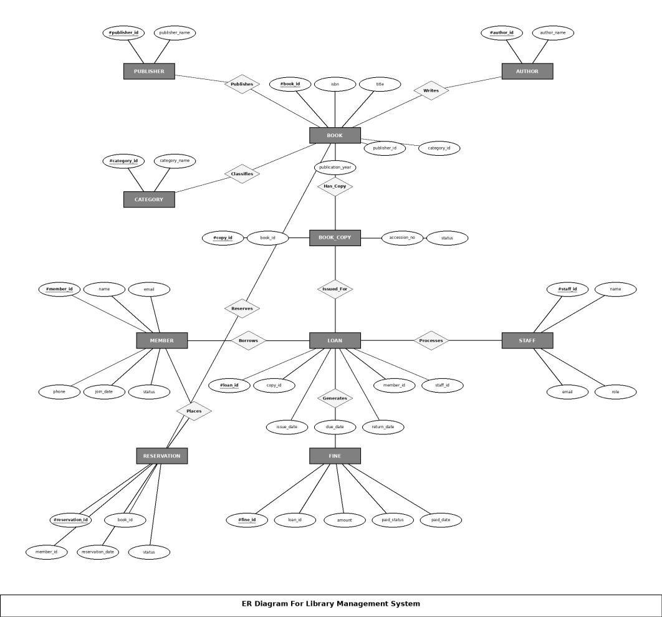
Figure 6.3: ER Diagram of the Library Management System
The main relationships shown in the diagram are:
One Publisher publishes many Books (1 : N).
One Member can borrow many Books (1 : N).
One Book can be borrowed by many Members over time (through Loan).
One Librarian issues many Loans (1 : N).
6.4 Relationships & Cardinality
Entity 1 | Relationship | Entity 2 | Cardinality (1:1 / 1:N / M:N)
Publisher | Publishes | Book | 1:N (one publisher publishes many books)
Member | Borrows | Book (via Loan) | 1:N (one member can borrow many books)
Book | Is borrowed through | Loan | 1:N (one book can be borrowed by many members over time)
Librarian | Issues | Loan | 1:N (one librarian issues many loans)

Slide 16
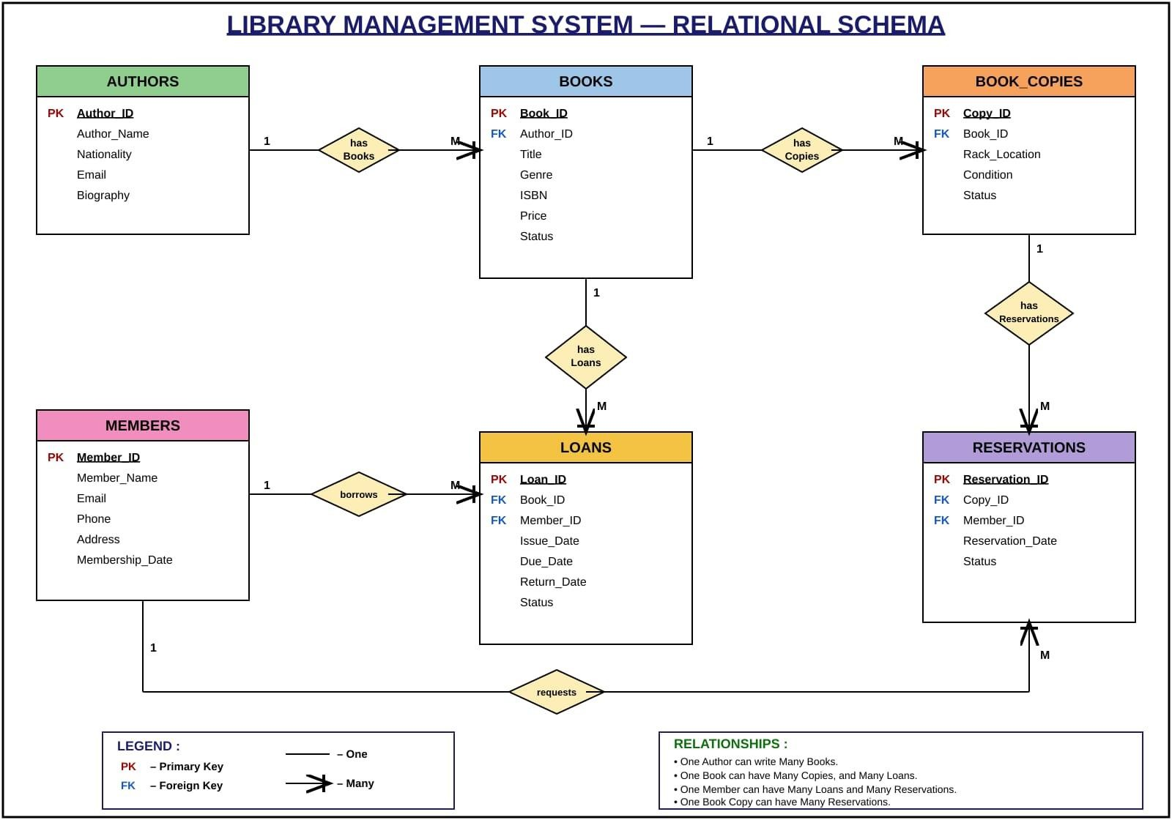
6.5 Relational Database Schema
The ER diagram is converted into the relational schema shown below. Each entity becomes a table, primary keys identify the rows and foreign keys implement the relationships.
Figure 6.5: Relational Schema of the Library Management System
Table Name | Column Name | Data Type | PK/FK/ — | Constraints
Book | Book_ID | INT | PK | PRIMARY KEY
Book | Title | VARCHAR(200) | — | NOT NULL
Book | Author | VARCHAR(100) | — | NULL allowed
Book | ISBN | VARCHAR(20) | — | UNIQUE
Book | Publisher_ID | INT | FK | FOREIGN KEY → Publisher
Book | Category | VARCHAR(50) | — | NULL allowed
Book | Price | DECIMAL(8,2) | — | NULL allowed
Book | Status | VARCHAR(20) | — | DEFAULT 'Available'
Book | Available_Copi es | INT | — | DEFAULT 1 (CHECK >= 0 optional)
Member | Member_ID | INT | PK | PRIMARY KEY
Member | Name | VARCHAR(100) | — | NOT NULL
Member | Email | VARCHAR(100) | — | UNIQUE

Slide 17
Table Name | Column Name | Data Type | PK/FK/ — | Constraints
Member | Phone | VARCHAR(15) | — | NULL allowed
Member | Address | VARCHAR(200) | — | NULL allowed
Member | Reg_Date | DATE | — | NULL allowed
Librarian | Librarian_ID | INT | PK | PRIMARY KEY
Librarian | Name | VARCHAR(100) | — | NOT NULL
Librarian | Email | VARCHAR(100) | — | NULL allowed
Librarian | Phone | VARCHAR(15) | — | NULL allowed
Loan | Loan_ID | INT | PK | PRIMARY KEY
Loan | Book_ID | INT | FK | FOREIGN KEY → Book
Loan | Member_ID | INT | FK | FOREIGN KEY → Member
Loan | Librarian_ID | INT | FK | FOREIGN KEY → Librarian
Loan | Issue_Date | DATE | — | NOT NULL
Loan | Due_Date | DATE | — | NOT NULL
Loan | Return_Date | DATE | — | NULL allowed (NULL = not yet returned)
Publisher | Publisher_ID | INT | PK | PRIMARY KEY
Publisher | Name | VARCHAR(100) | — | NOT NULL
Publisher | Address | VARCHAR(200) | — | NULL allowed
6.6 Primary & Foreign Keys
Entity Table | Primary Key (PK) | Foreign Key (FK) | Referenced Table | Purpose
Book | Book_ID | Publisher_ID | Publisher | Links each book to its publisher
Member | Member_ID | — | — | Base member record
Librarian | Librarian_ID | — | — | Base librarian record
Loan | Loan_ID | Book_ID | Book | Identifies the book that is issued
Loan | Loan_ID | Member_ID | Member | Identifies the member who borrowed the book
Loan | Loan_ID | Librarian_ID | Librarian | Records the librarian who issued the loan
Publisher | Publisher_ID | — | — | Base publisher record

Slide 18
7. DATABASE IMPLEMENTATION
7.1 DDL – Database and Table Creation
The database LibraryDB is created first, followed by the five tables in dependency order (parent tables before child tables). Constraints are declared directly in the CREATE TABLE
statements.
-- create the database
CREATE DATABASE LibraryDB;
USE LibraryDB;
CREATE TABLE Publisher ( Publisher_ID INT PRIMARY KEY,
Name VARCHAR(100) NOT NULL,
Address VARCHAR(200)
);
CREATE TABLE Book (
Book_ID INT PRIMARY KEY,
Title VARCHAR(200) NOT NULL, Author VARCHAR(100),
ISBN VARCHAR(20) UNIQUE,
Publisher_ID INT,
Category VARCHAR(50), Price DECIMAL(8,2),
Status VARCHAR(20) DEFAULT 'Available', Available_Copies INT DEFAULT 1,
FOREIGN KEY (Publisher_ID) REFERENCES Publisher(Publisher_ID)
);
CREATE TABLE Member ( Member_ID INT PRIMARY KEY,
Name VARCHAR(100) NOT NULL,
Email VARCHAR(100) UNIQUE, Phone VARCHAR(15),
Address VARCHAR(200), Reg_Date DATE
);
CREATE TABLE Librarian ( Librarian_ID INT PRIMARY KEY,
Name Email Phone
);
VARCHAR(100) NOT NULL,
VARCHAR(100), VARCHAR(15)
CREATE TABLE Loan (
Loan_ID INT PRIMARY KEY,
Book_ID INT, Member_ID INT,

Slide 19
Librarian_ID INT,
Issue_Date DATE NOT NULL, Due_Date DATE NOT NULL, Return_Date DATE,
FOREIGN KEY (Book_ID) REFERENCES Book(Book_ID),
FOREIGN KEY (Member_ID) REFERENCES Member(Member_ID), FOREIGN KEY (Librarian_ID)
REFERENCES Librarian(Librarian_ID)
);
7.2 Sample Data – DML
Representative records were inserted into all five tables, giving 9 rows in total.
Table | No. of Records | Sample Data / Reference
Publisher | 2 | Penguin Random House (New York), HarperCollins (London)
Book | 3 | The Great Gatsby, 1984, To Kill a Mockingbird
Member | 2 | Rahul Sharma (Delhi), Priya Patel (Mumbai)
Librarian | 1 | Anita Desai
Loan | 1 | Loan 1001 – book 103 issued to member 1
Total | 9
Insert statements:
-- Publishers
INSERT INTO Publisher VALUES (1, 'Penguin Random House', 'New York'); INSERT INTO Publisher VALUES (2, 'HarperCollins', 'London');
-- Books
INSERT INTO Book VALUES
(101, 'The Great Gatsby', 'F. Scott Fitzgerald', '978-0743273565', 1, 'Fiction', 12.99,
'Available', 3),
(102, '1984', 'George Orwell', '978-0451524935', 2, 'Dystopian', 10.50, 'Available', 2),
(103, 'To Kill a Mockingbird', 'Harper Lee', '978-0061120084', 1, 'Classic', 11.00, 'Issued',
1);
-- Members
INSERT INTO Member VALUES
(1, 'Rahul Sharma', 'rahul@email.com', '9876543210', 'Delhi', '2025-01-15'),
(2, 'Priya Patel', 'priya@email.com', '9123456780', 'Mumbai', '2025-02-10');
-- Librarians
INSERT INTO Librarian VALUES (1, 'Anita Desai', 'anita@library.com', '9988776655');
-- Loans
INSERT INTO Loan VALUES
(1001, 103, 1, 1, '2026-09-01', '2026-09-15', NULL);

Slide 20
Publisher – 2 rows
Publisher_ID | Name | Address
1 | Penguin Random House | New York
2 | HarperCollins | London
Book – 3 rows (selected columns)
Book_ID | Title | Author | Category | Price | Status | Copies
101 | The Great Gatsby | F. Scott Fitzgerald | Fiction | 12.99 | Available | 3
102 | 1984 | George Orwell | Dystopian | 10.50 | Available | 2
103 | To Kill a Mockingbird | Harper Lee | Classic | 11.00 | Issued | 1
Member – 2 rows
Member_ID | Name | Email | Phone | Address | Reg_Date
1 | Rahul Sharma | rahul@email.com | 9876543210 | Delhi | 2025-01-15
2 | Priya Patel | priya@email.com | 9123456780 | Mumbai | 2025-02-10
Librarian – 1 row
Librarian_ID | Name | Email | Phone
1 | Anita Desai | anita@library.com | 9988776655
Loan – 1 row
Loan_ID | Book_ID | Member_ID | Librarian_ID | Issue_Date | Due_Date | Return_Date
1001 | 103 | 1 | 1 | 2026-09-01 | 2026-09-15 | NULL
7.3 Constraints & Data Integrity
Constraint / Validation | Applied On | Purpose | Evidence
PRIMARY KEY | Book_ID, Member_ID, Librarian_ID, Loan_ID, Publisher_ID | Uniquely identifies each record and prevents duplicate key values. | Section 7.1
FOREIGN KEY | Book.Publisher_ID; Loan.Book_ID, Loan.Member_ID, Loan.Librarian_ID | Maintains valid relationships between related tables (referential integrity). | Section 7.1

Slide 21
Constraint / Validation | Applied On | Purpose | Evidence
NOT NULL | Book Title; Name in Member, Librarian and Publisher; Loan Issue_Date and Due_Date | Prevents missing values in mandatory attributes. | Section 7.1
UNIQUE | Book ISBN; Member Email | Prevents duplicate ISBN and e-mail values. | Section 7.1
DEFAULT | Book Status = 'Available'; Available_Copies = 1 | Provides default values when not explicitly supplied. | Section 7.1
CHECK (optional) | Available_Copies >= 0 | Restricts invalid or out-of-range values. | Section 7.3
The CHECK constraint is added to the Book table with an ALTER statement:
ALTER TABLE Book
ADD CONSTRAINT chk_copies CHECK (Available_Copies >= 0);
7.4 SQL Operations & Queries DDL, DML and DQL
Type | Purpose | Examples
DDL | Define structure | CREATE, ALTER, DROP, TRUNCATE
DML | Manipulate data | INSERT, UPDATE, DELETE
DQL | Query data | SELECT
S.No | Operation / Query | Purpose | SQL Query Ref.
1 | DDL – ALTER TABLE | Add a Language column to Book. | Listing below
2 | DML – UPDATE | Set the status of book 103 to Available. | Listing below
3 | DML – DELETE | Remove loan 1001. | Listing below
4 | DQL – SELECT with WHERE | List title and author of available books. | Listing below
5 | CRUD – CREATE | Add a new member. | Listing below
6 | CRUD – READ | List the books of the Fiction category. | Listing below
7 | CRUD – UPDATE | Reduce the available copies of book 101 by one. | Listing below
8 | CRUD – DELETE | Remove member 3. | Listing below

Slide 22
S.No | Operation / Query | Purpose | SQL Query Ref.
9 | JOIN (3 tables) | Show the books that are currently issued. | Listing below
10 | JOIN (3 tables) | Show the overdue books. | Listing below
DDL, DML and DQL operations
-- DDL
ALTER TABLE Book ADD COLUMN Language VARCHAR(30);
-- DML
UPDATE Book SET Status = 'Available' WHERE Book_ID = 103; DELETE FROM Loan WHERE Loan_ID = 1001;
-- DQL
SELECT Title, Author FROM Book WHERE Status = 'Available';
CRUD operations
-- Create
INSERT INTO Member VALUES
(3, 'Amit Kumar', 'amit@email.com', '9000011111', 'Bangalore', CURDATE());
-- Read
SELECT * FROM Book WHERE Category = 'Fiction';
-- Update UPDATE Book
SET Available_Copies = Available_Copies - 1 WHERE Book_ID = 101;
-- Delete
DELETE FROM Member WHERE Member_ID = 3;
Useful queries
-- Currently issued books
SELECT b.Title, m.Name, l.Issue_Date, l.Due_Date FROM Loan l
JOIN Book b ON l.Book_ID = b.Book_ID
JOIN Member m ON l.Member_ID = m.Member_ID WHERE l.Return_Date IS NULL;
-- Overdue books
SELECT b.Title, m.Name, l.Due_Date FROM Loan l
JOIN Book b ON l.Book_ID = b.Book_ID
JOIN Member m ON l.Member_ID = m.Member_ID WHERE l.Return_Date IS NULL
AND l.Due_Date < CURDATE();

Slide 23
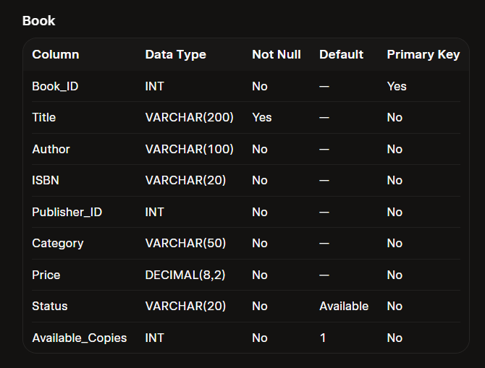
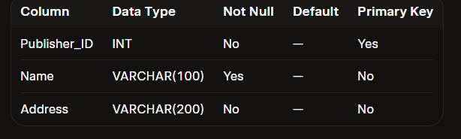
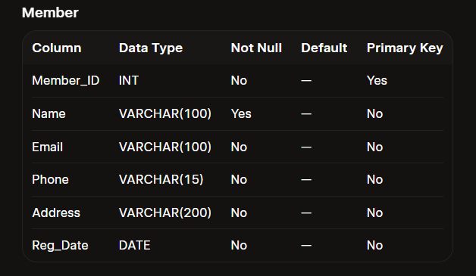
7.5 Sample Outputs
The following outputs show the structure of the tables created by the DDL statements in Section 7.1.
Output 1: Structure of the Book table
Output 2: Structure of the Publisher table
Output 3: Structure of the Member table

Slide 24
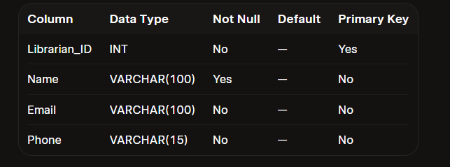
Output 4: Structure of the Librarian table

Slide 25
8. MODULES & FUNCTIONALITIES
S.No | Module | Functionality | Tables Involved
1 | Book Inventory Management | Maintains book records: title, author, ISBN, publisher, category, price, status and available copies. | Book, Publisher
2 | Member Registration | Registers members and stores their contact details and registration date. | Member
3 | Issue and Return of Books | Records each issue with its issue date, due date and return date, and the librarian who issued the book. | Loan, Book, Member, Librarian
4 | Due Date & Availability Tracking | Identifies currently issued and overdue books and tracks the status and number of available copies. | Loan, Book
5 | Data Integrity & Validation | Keeps data correct using primary keys, foreign keys and constraints. | All tables

Slide 26
9. GITHUB REPOSITORY & TEAM RESPONSIBILITIES
Repository Link: https://github.com/saimanish11887/Library-_management_-system.git
S.No | Team Member | Roll Number | Responsibility
1 | A. Ajay | 25B11AIB78 | Database Creation + Constraints
2 | T. Sai Manish | 25B11AIB78 | Sample Data + CRUD Operations
3 | T. Jaswanth | 25B11AIB83 | ER Diagram + Schema Design
4 | Y. Hemanth | 25B11AIC91 | Queries + Documentation + Presentation
Project Guide: Ms. G. Sravani, Assistant Professor (AIML)
10. ENHANCEMENTS & FUTURE IMPROVEMENTS
The current database can be extended with new features such as fines, reservations and multiple library branches. Planned improvements include:
Web / mobile front-end for members and librarians.
Fine calculation for overdue books.
Book reservation system.
Reports and analytics dashboard.

Slide 27
11. CONCLUSION
A complete Library Management System database was successfully designed and implemented. The project applied the core DBMS concepts: ER modeling, relational schema design, keys, constraints, DDL, DML and DQL statements, and CRUD operations.
The system ensures data integrity through primary keys, foreign keys and constraints, and it can be easily extended with features such as fines, reservations and multiple branches.
Key concepts applied
ER modeling and conversion of the ER diagram into a relational schema.
Primary keys, foreign keys, NOT NULL, UNIQUE, DEFAULT and CHECK constraints.
DDL, DML and DQL statements and CRUD operations.
Join queries to find currently issued and overdue books.
12. REFERENCES
GitHub repository:https://github.com/saimanish11887/Library-_management_-system.git
DBMS Cornerstone Project Review (Review II) presentation – Library Management System.
Aditya University – DBMS Project documentation template.

